Slide 1
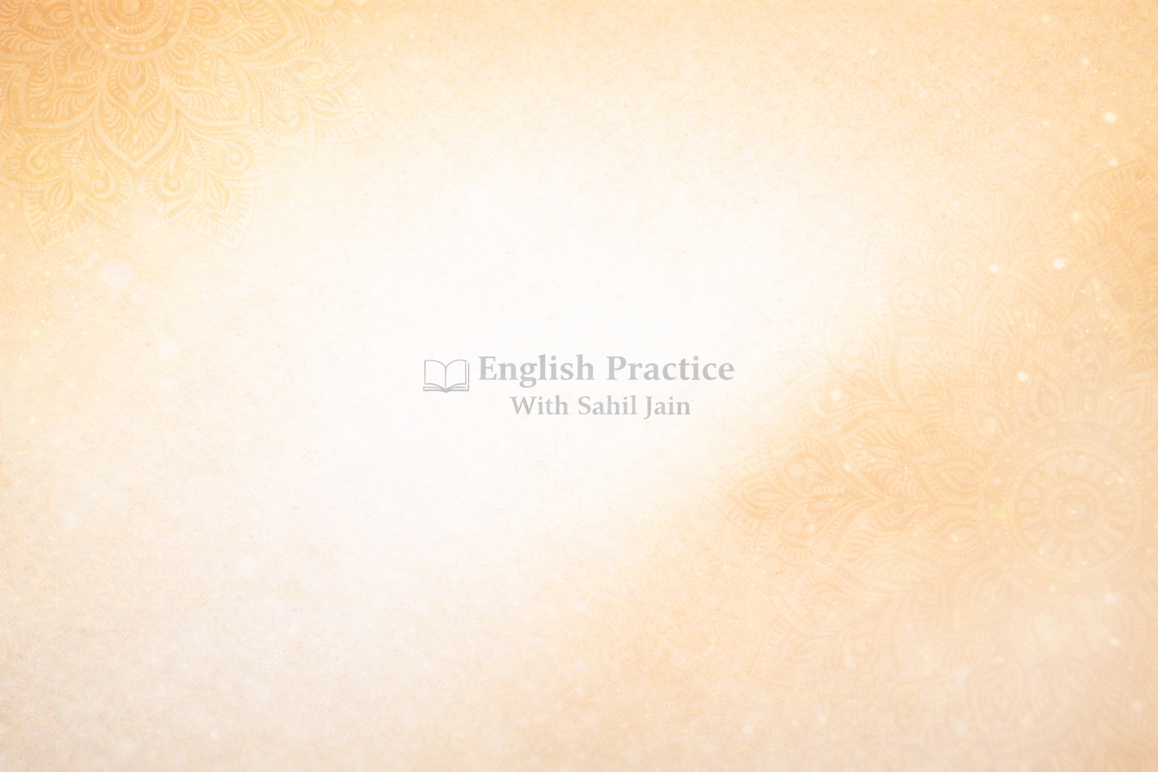
It May Sound Crazy… But This Is What Women Actually Want
(Inspired by Machiavellian ideas, explained simply)
This may sound strange, but what I am about to tell you is the complete opposite of what you have been taught about women.

Slide 2
It goes against what your mother said, what society calls “right,” what romantic movies showed you, and what your past relationships made you believe.

Slide 3
Forget all of that for a moment.
More than 500 years ago, Machiavelli closely observed powerful women in the royal courts of Europe.

Slide 4
What he noticed was dangerous—so dangerous that he never wrote it openly.
If these ideas had become public at that time, his life could have been destroyed.

Slide 5
Today, those ideas are being explained in a safe and modern way.

Slide 6
This book will share simple principles that help you interact with women confidently—without begging, without chasing, and without losing your self-respect.

Slide 7
Instead of running after attention like most men, you will become the man whose attention women themselves want.

Slide 8
But understand this clearly:
The most powerful idea works only when you first understand and master the earlier ones.

Slide 9
Confidence Comes From Abundance, Not Need
Most men make one big mistake.
They behave as if their attention is rare and fragile—as if one woman is their last chance.

Slide 10
This mindset slowly kills attraction, even if the man does not realize it.
The truth is simple:
Women do not react to words.
They react to energy.

Slide 11
Needy energy is deeply unattractive.

Slide 12
Confidence is born when you feel complete within yourself—when you do not need anyone’s approval to feel okay.
When this belief settles inside you, your behavior automatically changes.

Slide 13
You become calm.
You stop looking desperate.
You stop explaining yourself.

Slide 14
Women observe very carefully, especially under pressure.
They notice whether you are relaxed or anxious, confident or needy.
Men who appear needy look weak.

Slide 15
Men who carry themselves calmly, with a sense of abundance, project power.

Slide 16
Without realizing it, her mind starts asking questions:
“If he gives me so much attention, why are other women not chasing him?”
“If no one else wants him, why should I?”
These reactions are not logical.

Slide 17
They are instinctive.

Slide 18
Just like anything that is always available loses value, and anything people compete for becomes valuable.
How to Show Abundance in Real Life
First:
Make your life a priority.

Slide 19
If you have work, gym, friends, or goals, do not cancel them instantly for anyone.

Slide 20
If she asks to meet and you are busy, say calmly:
“I already have plans that day.
Thursday evening works for me.”
No excuses.
No guilt. No apologies.

Slide 21
This shows your life is full.
Second:
Do not communicate with desperation.

Slide 22
You do not need to reply instantly to every message—not to play games, but because your life is genuinely active.
When you reply, do it with respect and presence.

Slide 23
But never apologize for having a life.
Constantly saying “sorry” shows insecurity, not kindness.
Third:
Open up emotionally—slowly. Do not share your entire life story at once.

Slide 24
Opening too fast creates pressure, not connection.
Mystery keeps attraction alive.
Trust grows step by step. Remember:
Abundance is not arrogance. A man with real options does not show off.

Slide 25
He does not compete.

Slide 26
He invests in himself, his growth, and his purpose.
This quiet confidence is deeply magnetic.

Slide 27
Value Her, But Never Idolize Her
There is a big difference between valuing someone and idolizing them.

Slide 28
To value someone means:
Treating her as a human being
Listening to her
Respecting her time and opinions
But idolizing is dangerous.

Slide 29
Idolizing means putting her above yourself.
Acting as if she is perfect.
Tolerating behavior you would never accept from anyone else.

Slide 30
This mindset says:
“I like you, so I will accept anything.”
This kills attraction.

Slide 31
Machiavelli once said,
“A man who becomes a sheep will be eaten by wolves.”
In relationships, this is very true.
When men worship women, tension disappears.

Slide 32
And without tension, attraction dies.
Predictability slowly destroys desire.

Slide 33
Boundaries Are Not Rudeness — They Are Self-Respect
If she comes late without informing you:
A man who idolizes says:
“It’s okay, no problem,”
while feeling hurt and insecure inside.

Slide 34
A man who values says calmly:
“I respect my time.
Please inform me next time if you are late.”
One man seeks approval.
The other shows boundaries.

Slide 35
Women may not analyze this consciously, but they feel the difference instantly.
Boundaries communicate:
Strength
Confidence
Emotional stability
A man who agrees to everything looks weak.

Slide 36
A man who can disagree calmly shows backbone.
Compliments Should Have Depth
Most men only compliment looks: “You’re beautiful.”
“You’re cute.”
These fade quickly.

Slide 37
Real impact comes when you notice her depth:
Her intelligence
Her decisions
Her calm under pressure
For example:
“I like how you stay clear-headed even in stressful situations.”
This makes her feel seen—not just looked at.

Slide 38
Respect does not mean tolerating disrespect.
If a boundary is crossed, say calmly:
“I don’t like this.
Let’s find a better way.”
No anger. No lectures. Just clarity.

Slide 39
Emotional Independence Is Real Power
Emotional independence does not mean being cold.
It means your emotional balance does not depend on one person.
You can care deeply.

Slide 40
You can invest fully.

Slide 41
But you do not lose yourself.
A man who can calmly walk away when needed shows true confidence.

Slide 42
He communicates silently:
“I want you, but I do not depend on you.”
This energy is rare—and rarity creates attraction.

Slide 43
The Real Secret
Attraction does not depend only on how you treat a woman.
It depends on how you treat yourself.

Slide 44
Women are drawn to men who:
Respect their own life
Protect their boundaries
Maintain their standards
This is not arrogance.
This is quiet confidence.

Slide 45
Attraction is not built through tricks, scripts, or games.
It grows from:
Self-control
Emotional stability
A purposeful life
When you are stable inside, the outside world responds.

Slide 46
Machiavelli did not write about attraction directly, but he understood power.
And the rule of power is simple:
The man who controls himself influences others.

Slide 47
Final Note
Do not use this knowledge to manipulate.
Use it to become better.
First, respect yourself. First, become complete. Everything else will align naturally.

Slide 48
Because the man who masters his mind
eventually shapes his life.

